Slide 1

Salesforce Technical Architect-Home Assessment
Usha Gaikwad
Thursday, November 9, 2023

Slide 2

Problem Statement
Contentful.com is a Content Management System as a service. That means you can use the API to create, publish, and display content that is authored in Markdown. As a part of this challenge, you need to create Lightning Components that display the post list view & detail view.
Requirements:
Using a Contentful.com trial account and the blog sample space, create a Salesforce.com lighting component to display a paginated list view of “posts” from contentful.
2. Document how you can modify and or reuse your controller to supply a “filtered” to a listview of “posts”
3. Create an LWC detail view of a “post” and render the stored markdown in HTML, Clicking the title of the “post” in the list view should open this detail view.
4. Ensure to write quality unit tests.
Thursday, November 9, 2023

Slide 3
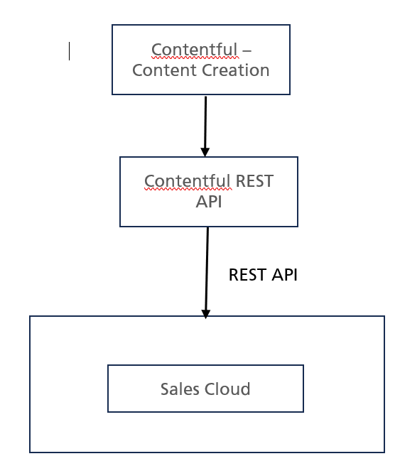
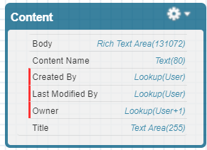
Salesforce Technical Architect – Home Assessment
System Landscape
Object Model
Solution Approach
Content__c
Create account in Contentful. Select Content Model type and create content.
Using Postman validate REST API exposed for published / unpublished contents.
In Salesforce create Remote site setting for https://cdn.contentful.com for published contents.
Using Contentful REST API fetch contents in Salesforce custom object Content__c.
Create LWC components for
Display post list
Filter post
Click specific content to open detail view
Post related to Mardown changing to HTML format
Thursday, November 9, 2023

Slide 4
Implementation Details
LWCContentController
Contentful REST API
Load content in salesforce
Content
LWC Components
Hierarchical LWC
LWC Components
Parent LWC – contentSearch
contentDetail
Custom event -
Child LWC - contentSearchFrom
LMS
Pub property- searchText
markdownPreview
Child LWC – contentSearchResult
Thursday, November 9, 2023

Slide 5




Thank you
Usha Gaikwad
Principal Architect

